Slide 1
The problem
This project was aimed to used sentiment analysis to determine whether to recommend this restaurant based on their reviews
It can benefit the business by taking into consideration the reviews by various consumers
Finally, to attain a common ground for recommending a restaurant based on reviews

Slide 2
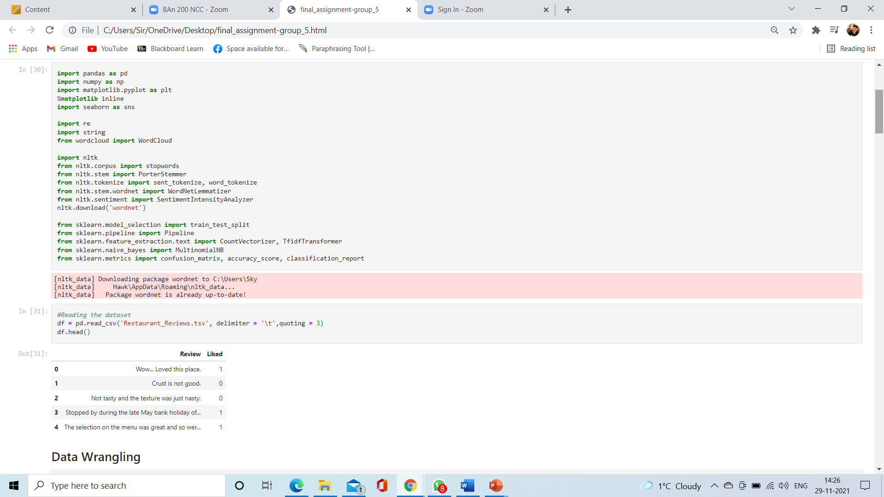
Importing and Loading

Slide 3
Transformations
We started with the data wrangling and text mining, which cover change text into tokens, remove punctuation, numbers, stop words.

Slide 4
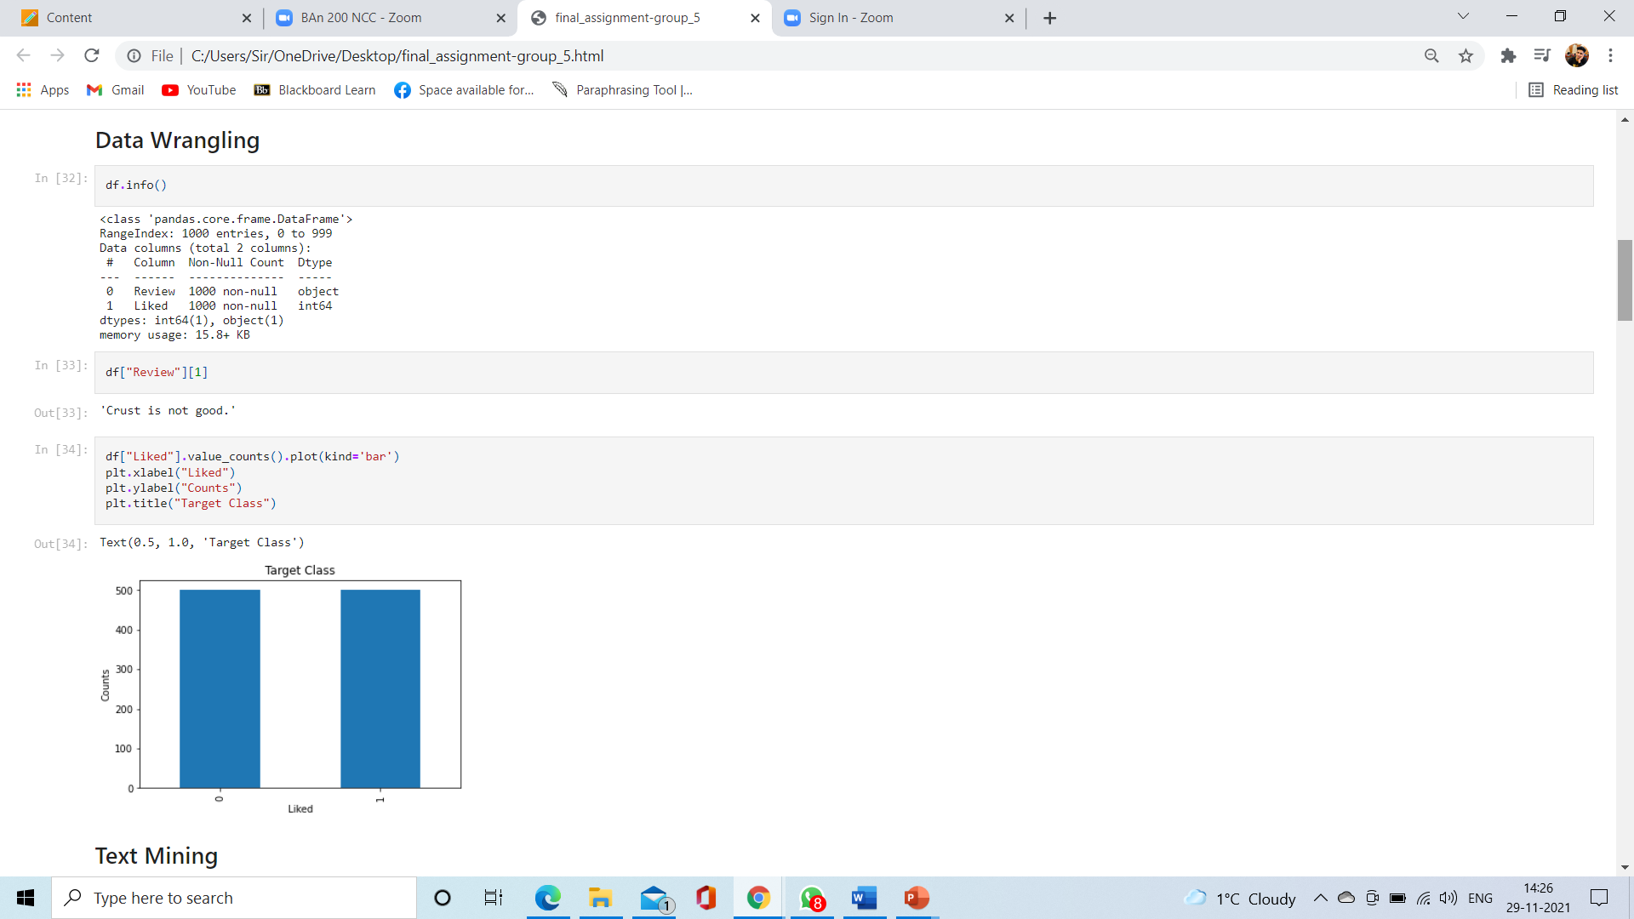
Data Wrangling

Slide 5
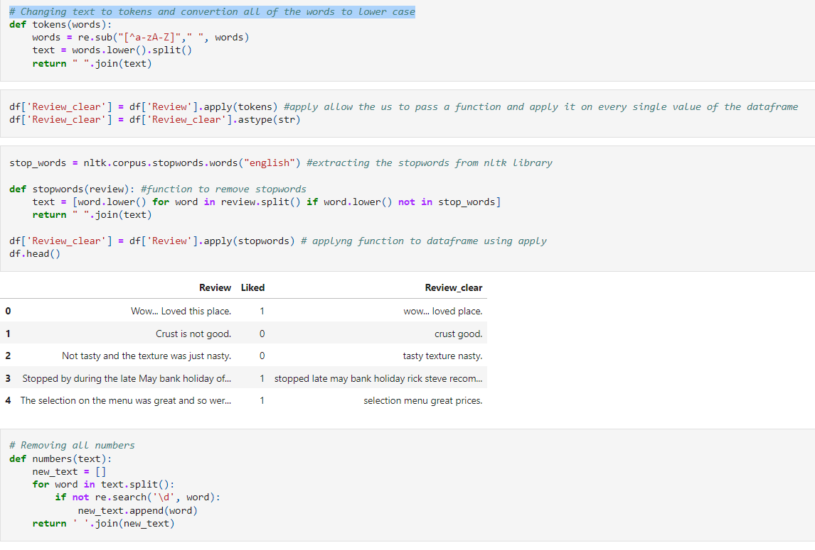
Text Mining

Slide 6
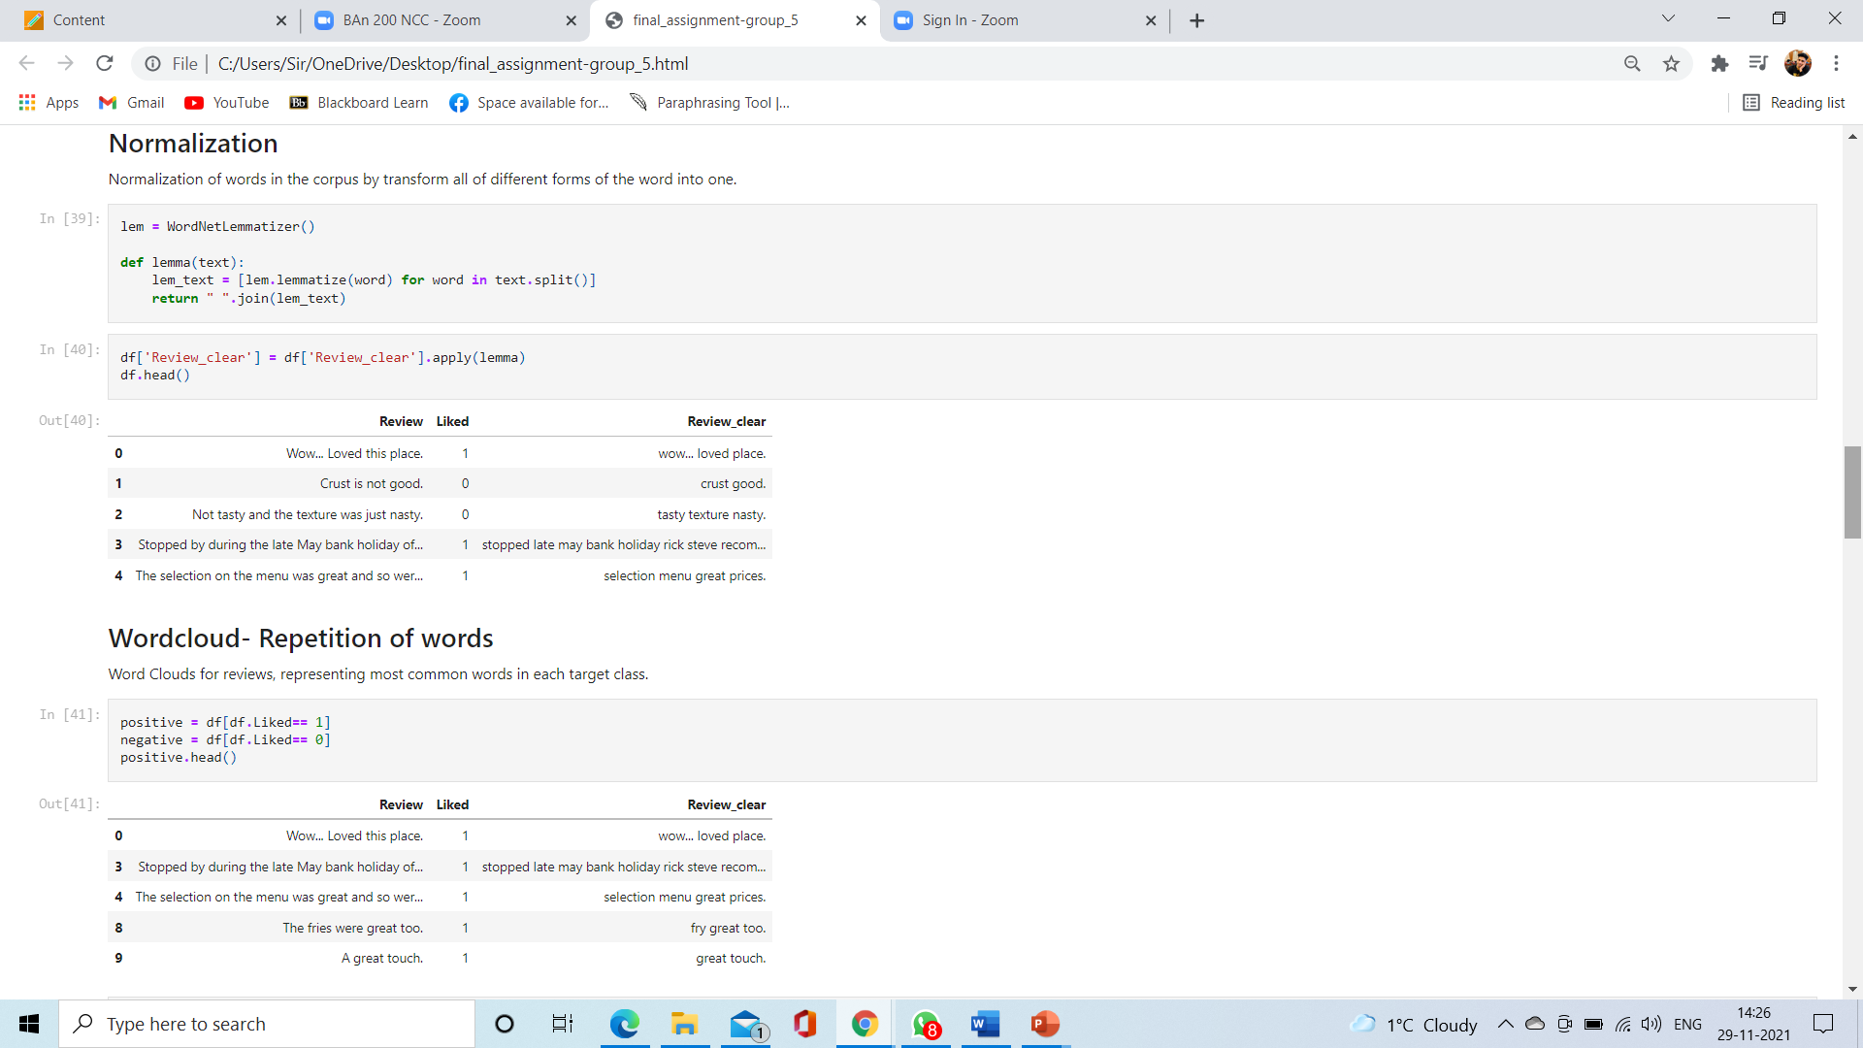
Normalization of words in the corpus by transforming all of different forms of the word into one.

Slide 7
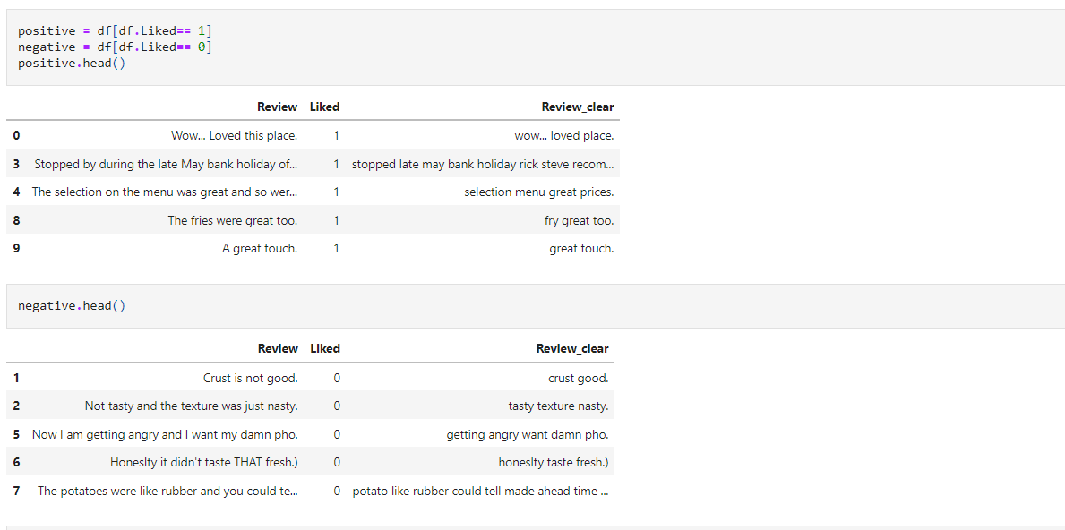
Wordcloud (Repetition of words)

Slide 8
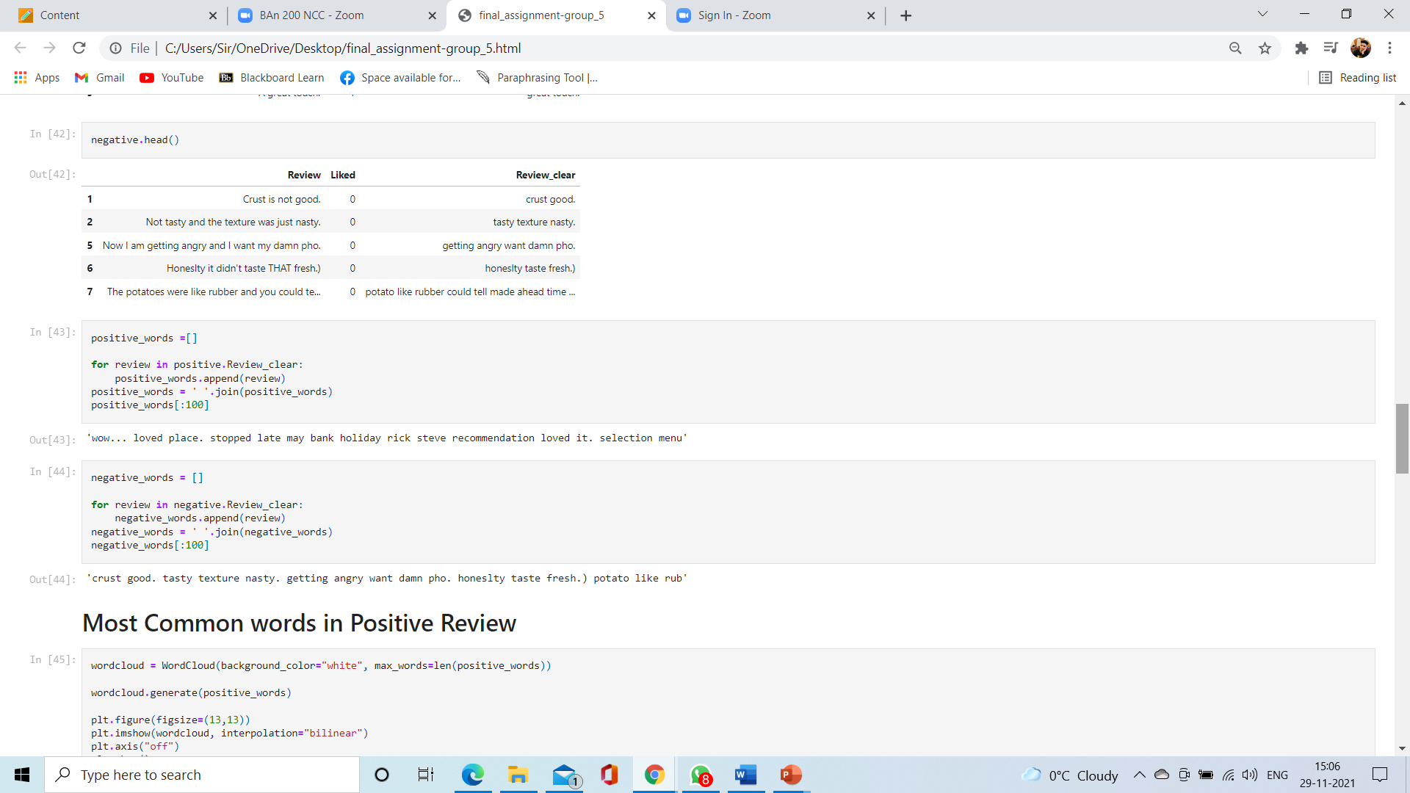
Word Clouds for reviews, representing most common words in each target class

Slide 9
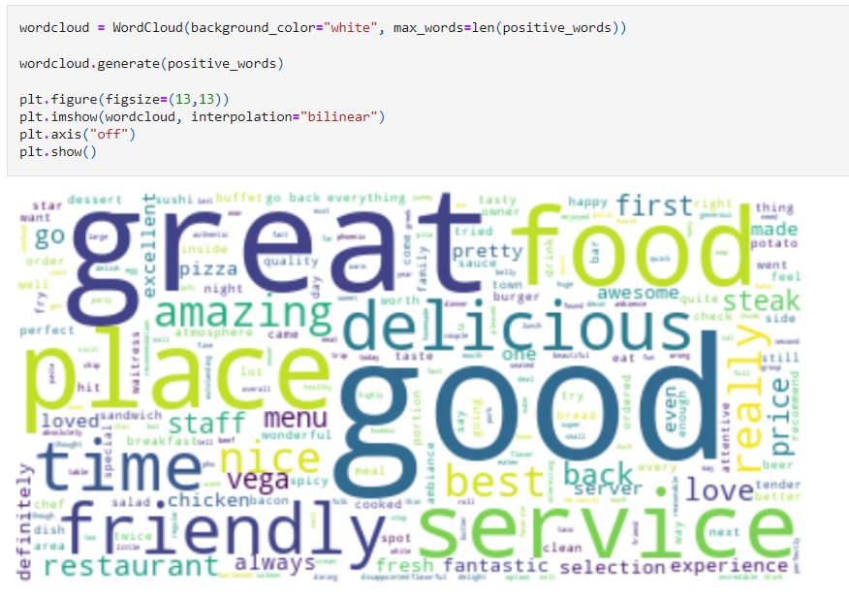
Most Common words in Positive Review

Slide 10
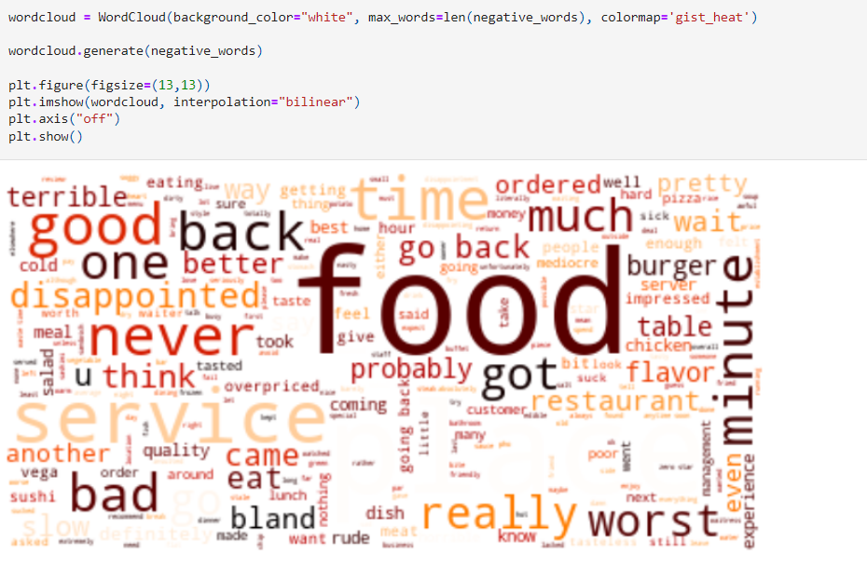
Most Common words in Negative Review

Slide 11
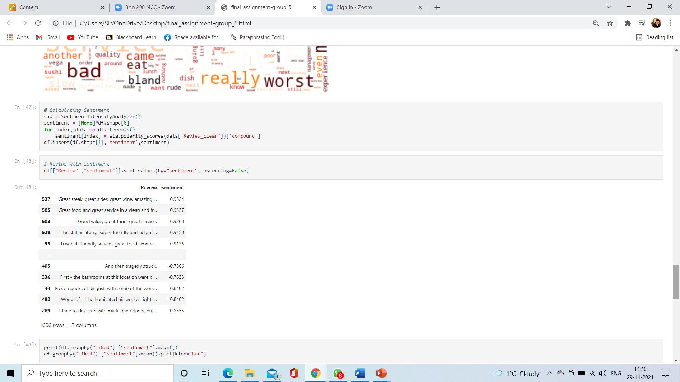
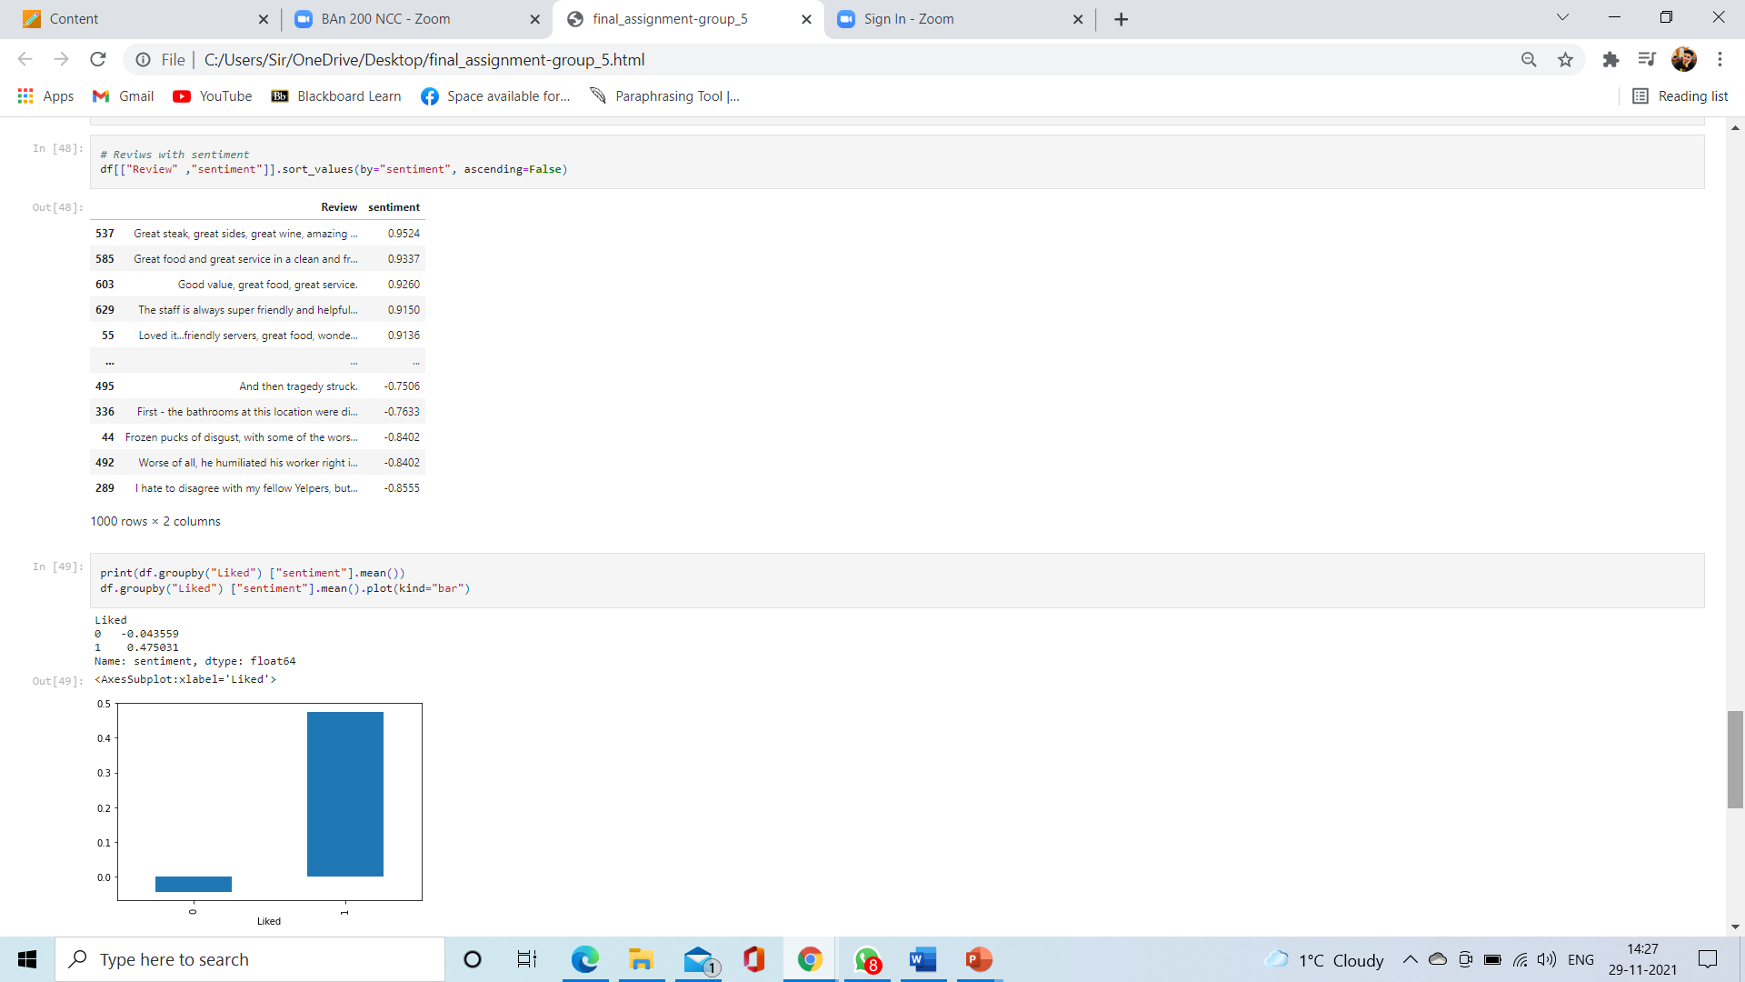
Sentiment analysis

Slide 12
model
We use the following classification models:
NAIVE BAYES To run machine learning algorithms we need to convert text files into numerical feature vectors.
On top of that, We will use bag of words model for our analysis

Slide 13
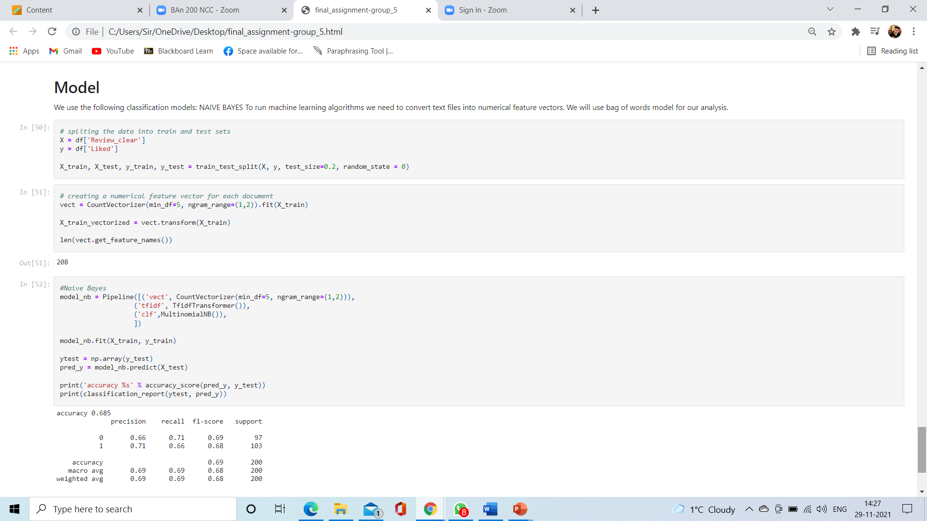

Slide 15
Conclusion
This project was aimed to used sentiment analysis to determine whether to recommend this restaurant based on their reviews.
We started with the data wrangling and text mining, which cover change text into tokens, remove punctuation, numbers, stop words and normalization them by using lemmatization.
Following we used bag of words model to convert the text into numerical feature vectors.
Finally, we started training different Classification models and we got the accuracy of 0.685 for Naive Bayes

